Slide 1
Dashboard Development with R and Shiny
Raden Muhammad Hadi

Slide 2
About Me
Math Graduate with specialization in Algebra (a.k.a Abstract Nonsense)
Basically Non Tech Geek
Sometimes I play with semicolon
Web Programmer (Java) @ Tabel Data Informatika
Sometimes I hate them
Mathematical Modeler - Software Engineer (Python) @ Quantus Telematika Indonesia
Numpy sucks, matrix-based programming language is best!
Statistical Consultant & Shiny Developer (R) @ StatsMaster

Slide 3

Why R

Slide 4
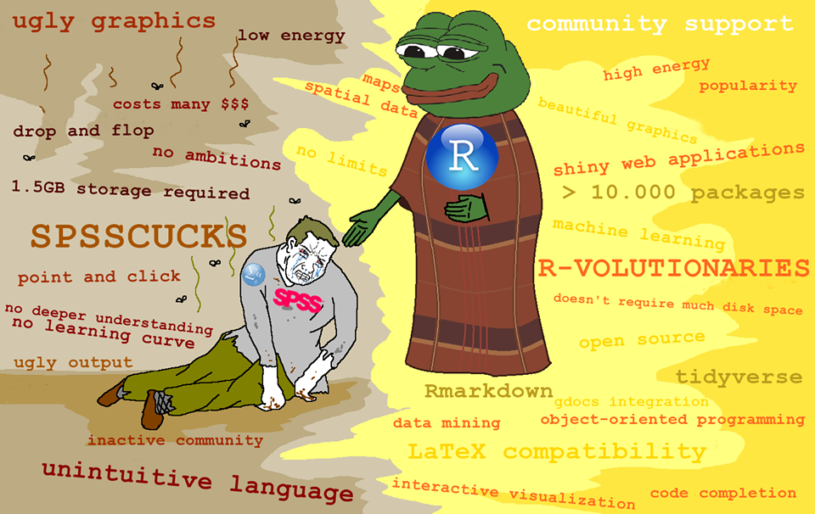

Slide 5
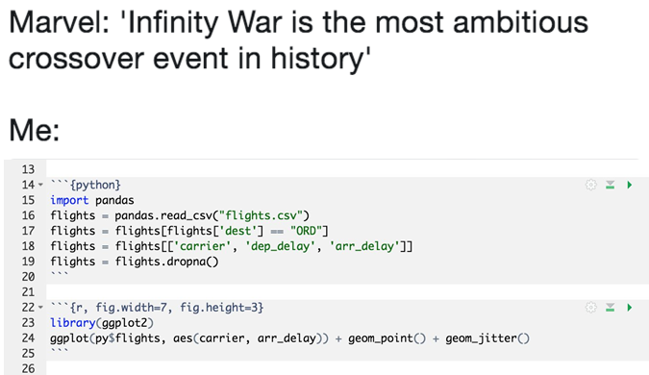

Slide 6
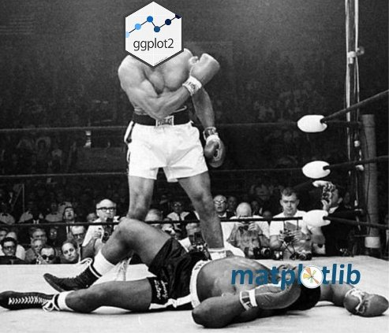

Slide 7


Slide 8
Hands-On Basic - R

Slide 9

Why Shiny

Slide 10
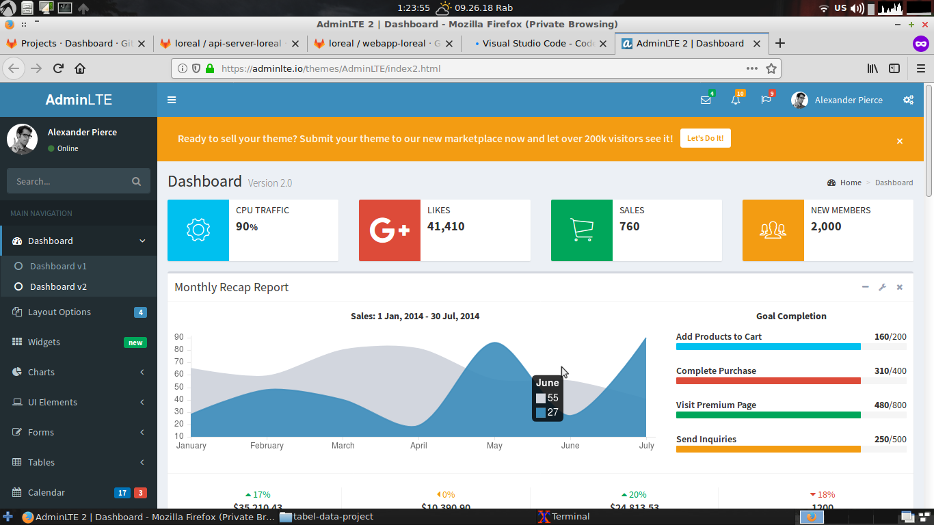

Slide 11
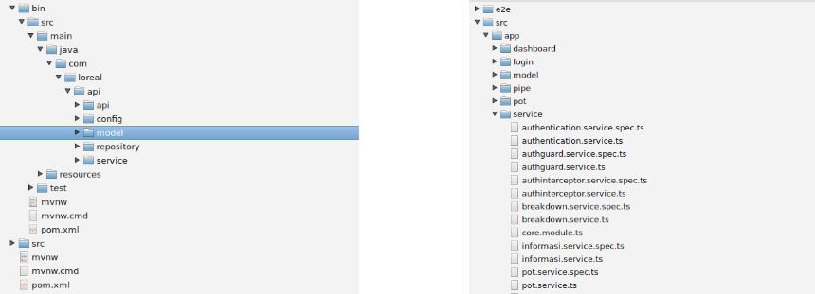
Server Side
Client Side

Slide 12



Slide 13
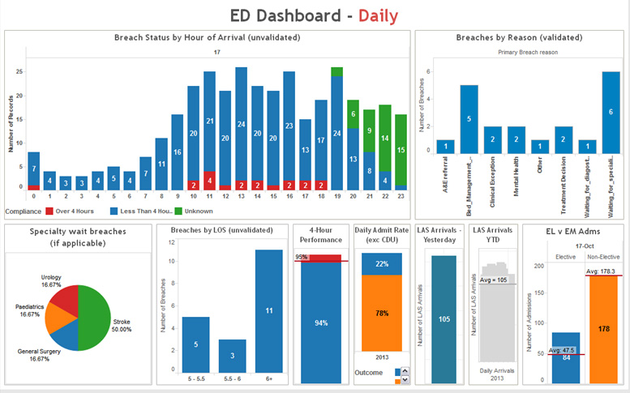

Slide 14
?

Slide 15


Slide 16
Why Shiny
Use (only) one language to build a nice dashboard app
Reactive and responsive design
Suitable for manipulation of data
No need for HTML/CSS/Javascript for starter
Simple yet powerful enough to implement machine learning algorithm and data analytics: caret, e1071, ts, cluster, mxnet, keras, etc
Open source library and free to use.
Lower the expertise bar for making great looking apps.

Slide 17
Demo Basic Shiny App

Slide 18
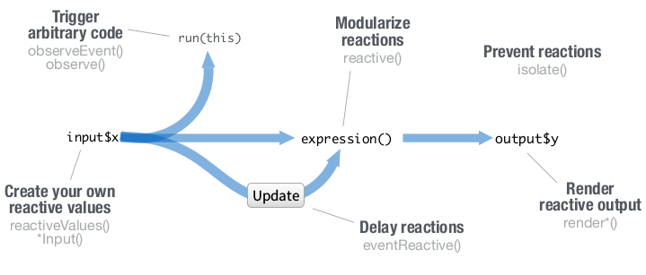
How it works

Slide 19
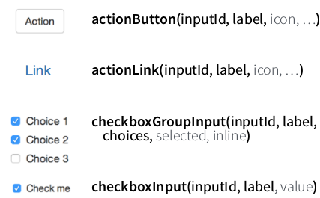
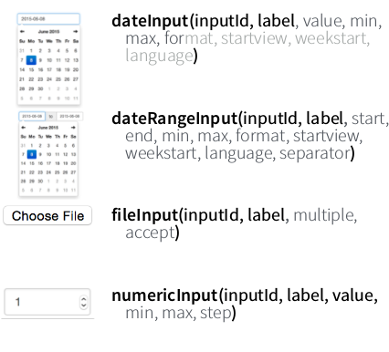
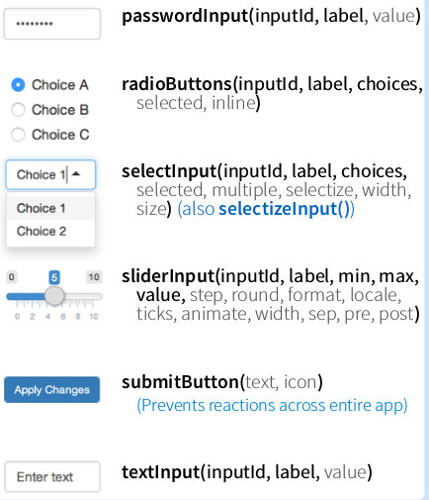
Web Component - Basic Input

Slide 20
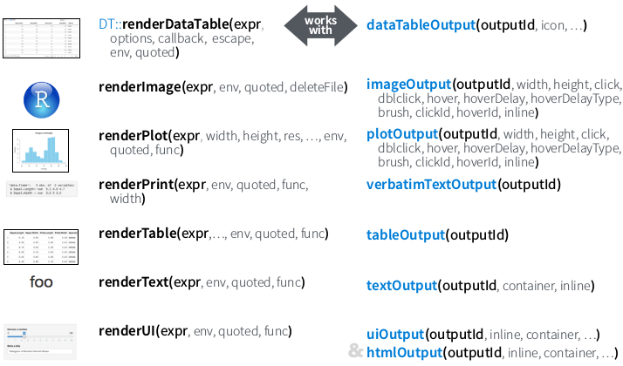
Web Component - Basic Output

Slide 21
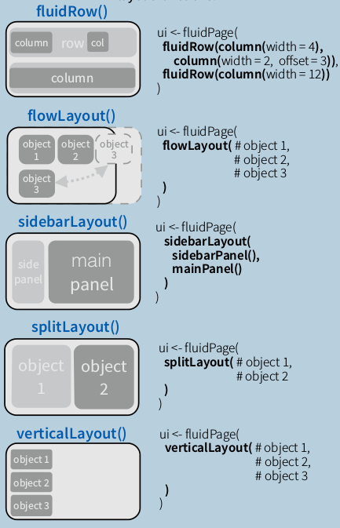
5 Basic Layouts

Slide 22
Where to deploy?
Cloud (a.k.a someone else computer)
Shinyapps.io
AWS
Any cloud service
Locally
Shiny Server

Slide 23
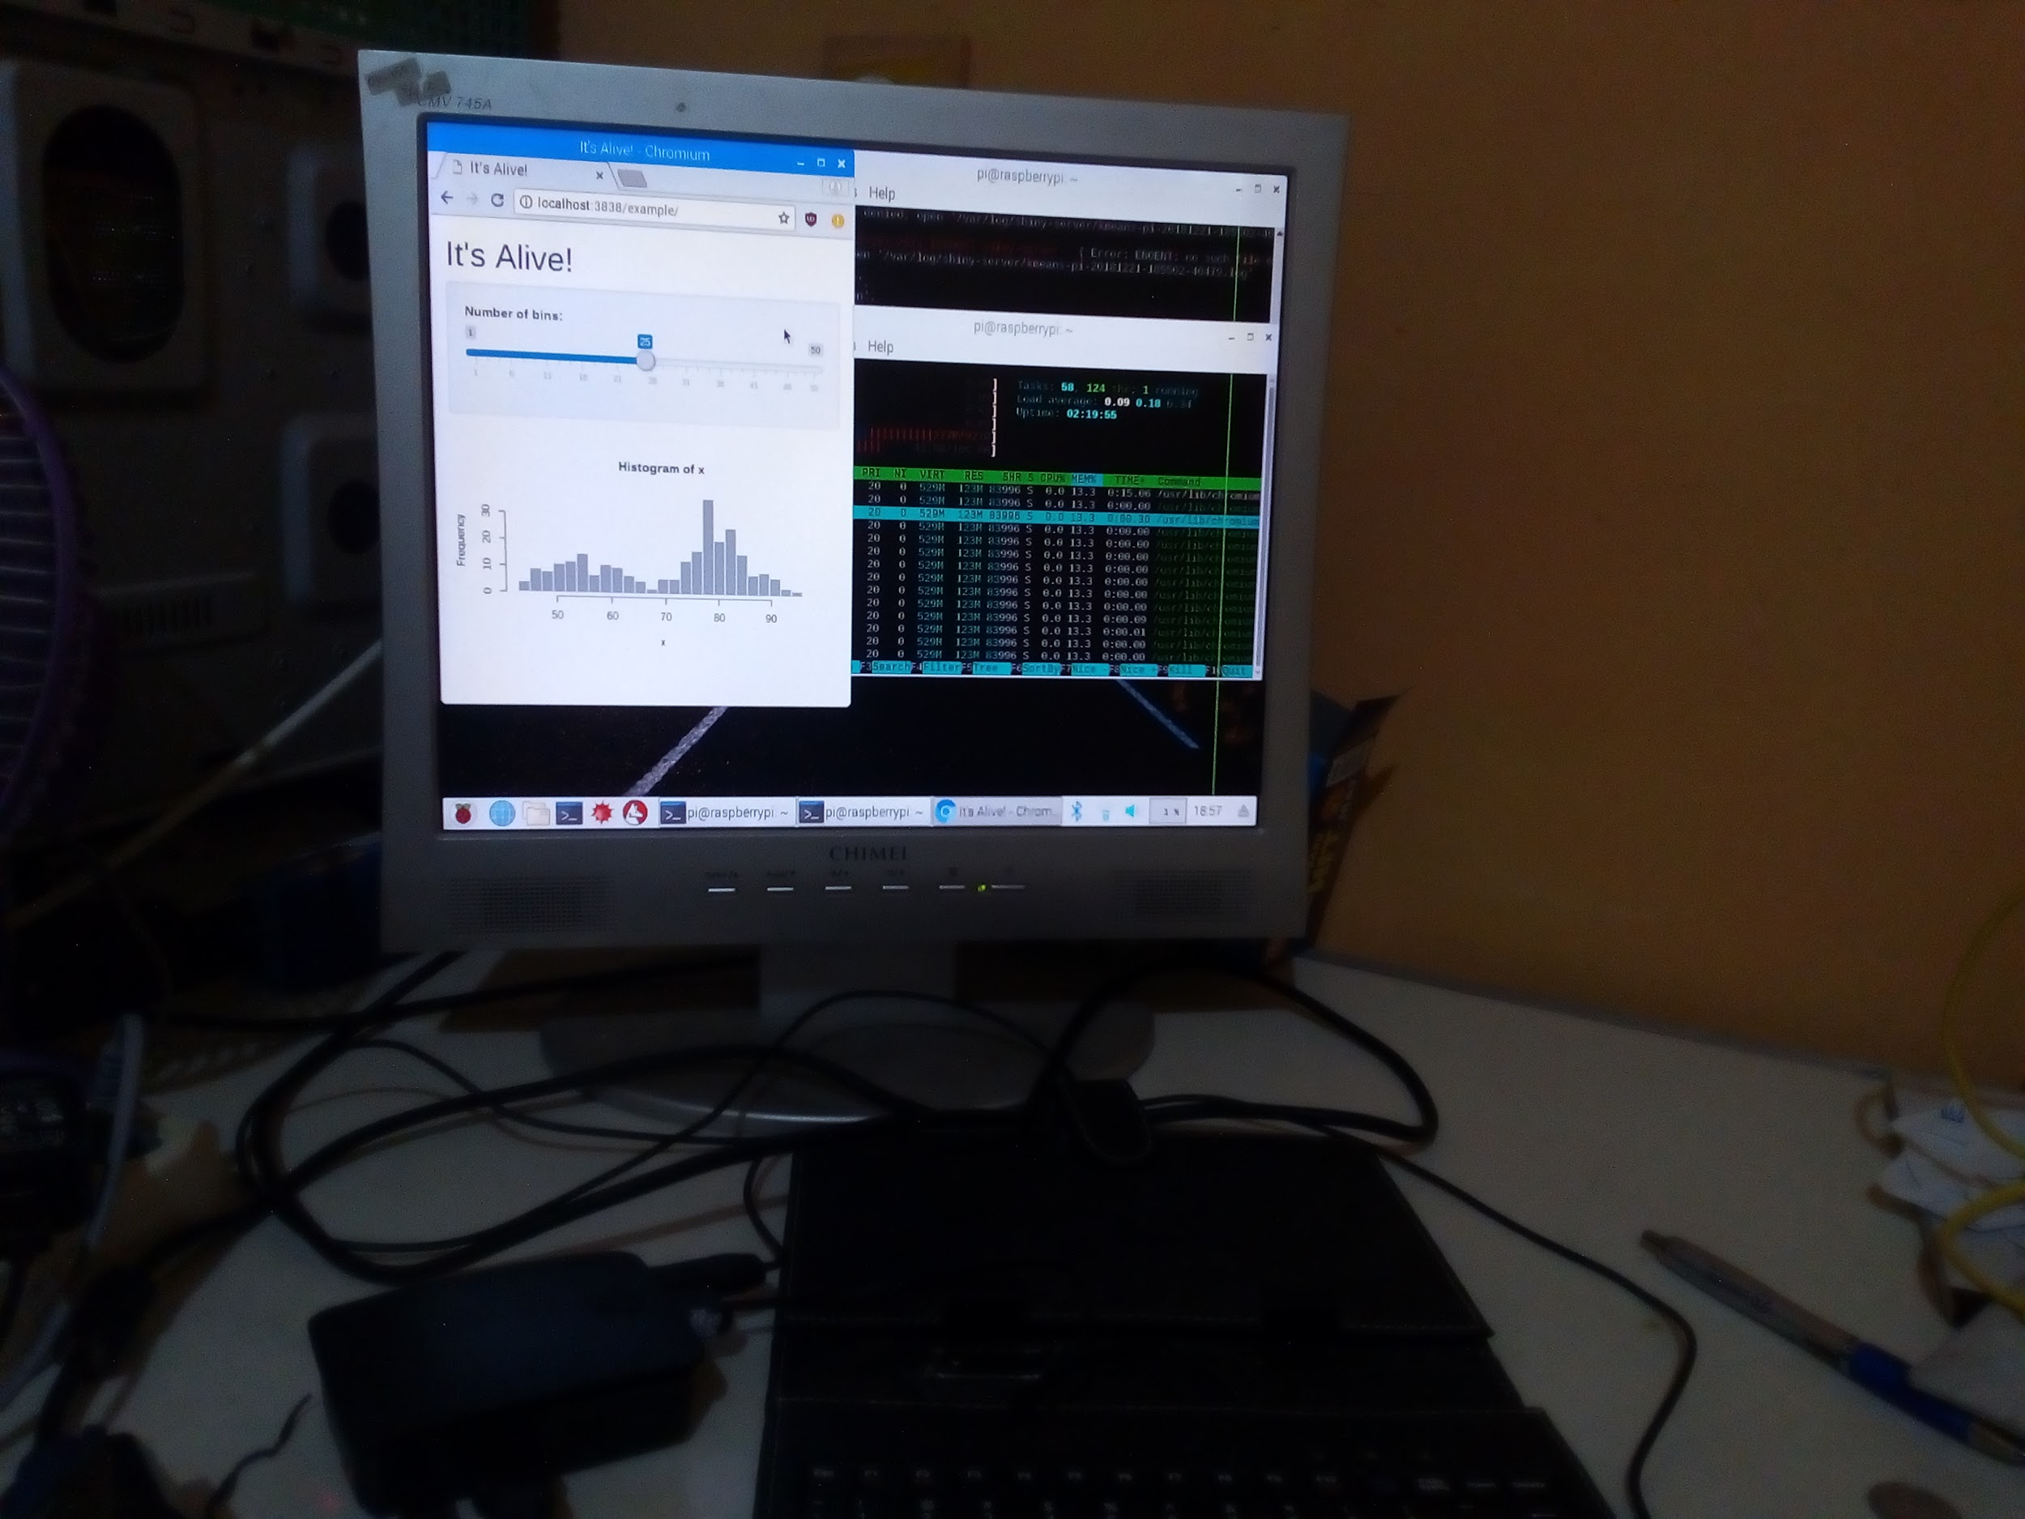
Shiny Server on Raspberry Pi 3 B+

Slide 24
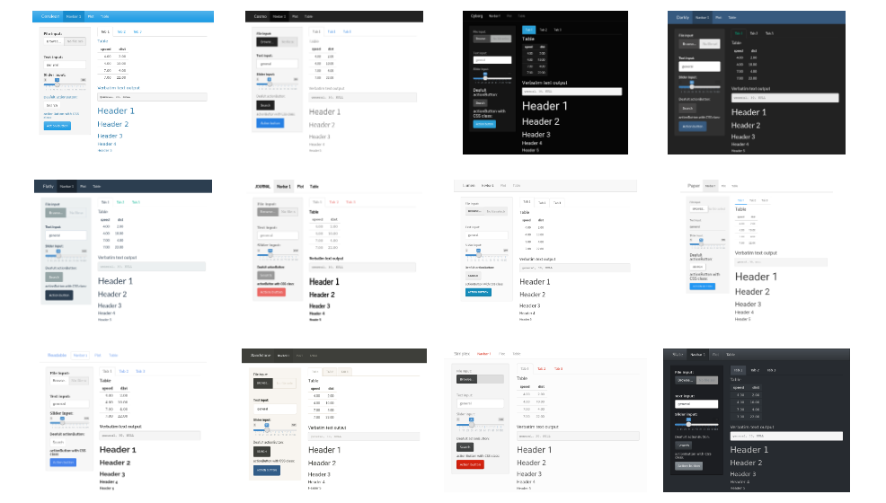
ShinyThemes: Customized Themes for Shiny

Slide 25
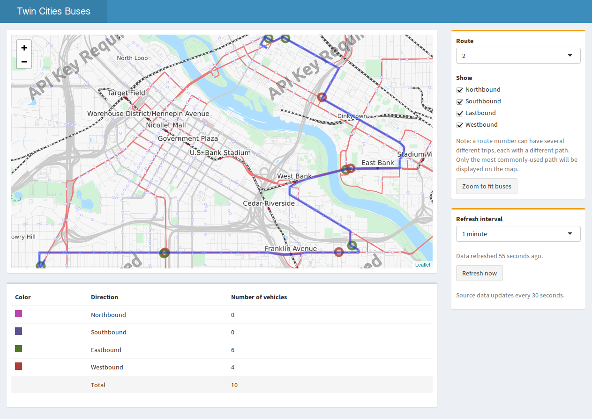
Another Modern Dashboard Templete:
Admin LTE

Slide 26
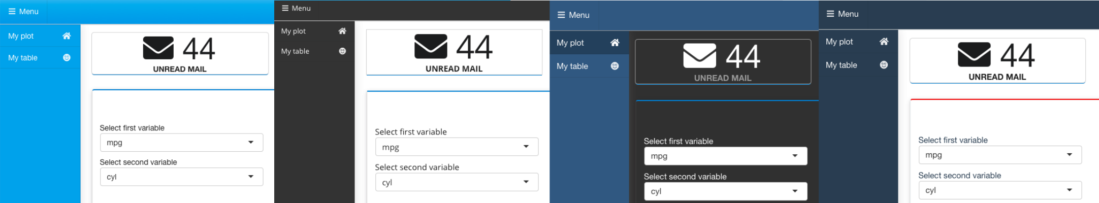
Another Modern Dashboard Template: Semantic

Slide 27
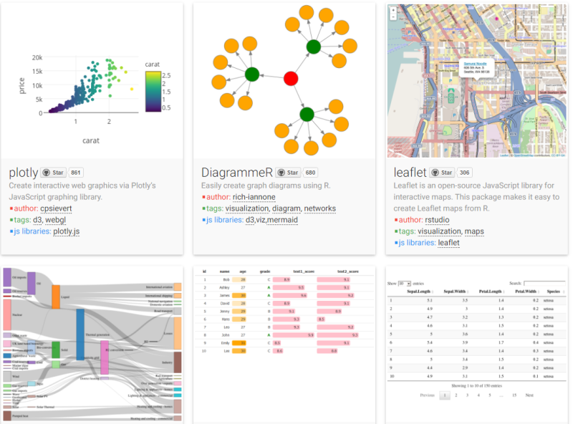
HTMLWidget

Slide 28
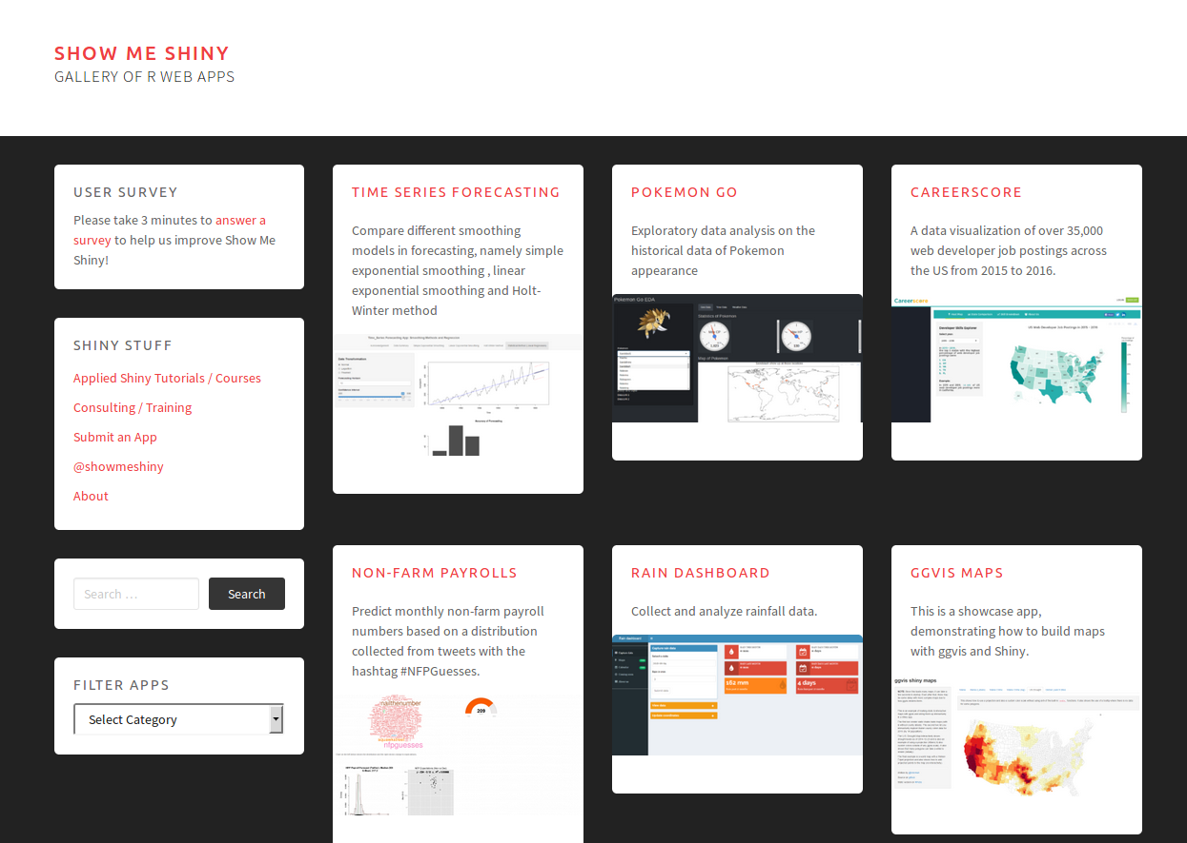
Other Examples
Rstudio – Shiny:
https://shiny.rstudio.com/gallery
Show Me Shiny:
https://www.showmeshiny.com/
Shinyapps Gallery:
https://shinyapps-recent.appspot.com

Slide 29
Other Web Framework for R
OpenCPU: https://www.opencpu.org/
Jug: http://bart6114.github.io/jug/
Fiery: https://github.com/thomasp85/fiery
Plumber: https://www.rplumber.io/
ShinyProxy: https://www.shinyproxy.io/

Slide 30

Join Our Telegram Group!
https://t.me/GNURIndonesia

Slide 31
Thanks!
Linkedin: bit.ly/radenmuhammadhadi
Github: github.com/hadimaster65555
Github-page: hadimaster65555.github.io

